Slide 1
Battery Testing, Data Analysis, and Modeling Using MATLAB and Simulink
Eric Wetjen, Product Marketing
John Lee, Consulting Services
Javier Gazzarri, Application Engineering

Slide 2
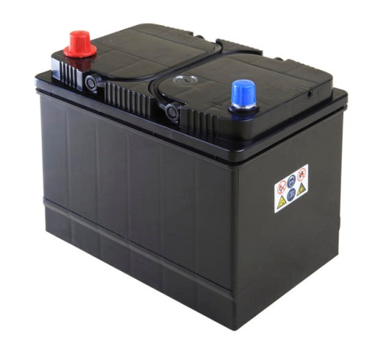

Slide 3

Output Voltage (V)
Discharge current (A)
Battery Temperature (ºC)
ΔT = +16ºC
State of Charge

Slide 4


© IEEE 2012

Slide 5

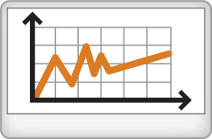




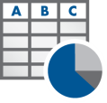


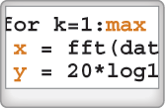


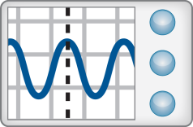
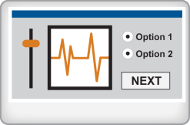
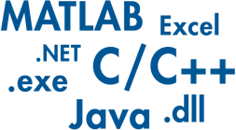
A Technical Computing Workflow for Battery Test and Data Analysis
Access
Explore & Discover
Share
Files
Reporting and Documentation
Data Analysis & Modeling
Software
Algorithm Development
Outputs for Design
Code & Applications
Application Development
Hardware
Deployment
Automate

Slide 6
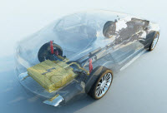
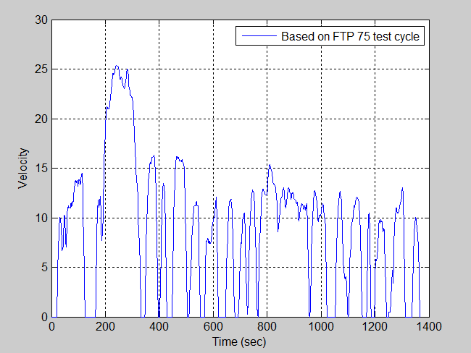
Battery Testing, Data Analysis, and Modeling Using MATLAB and Simulink
Notes:
Battery testing and data analysis, Battery testing and analysis using MATLAB and Simulink

Slide 7
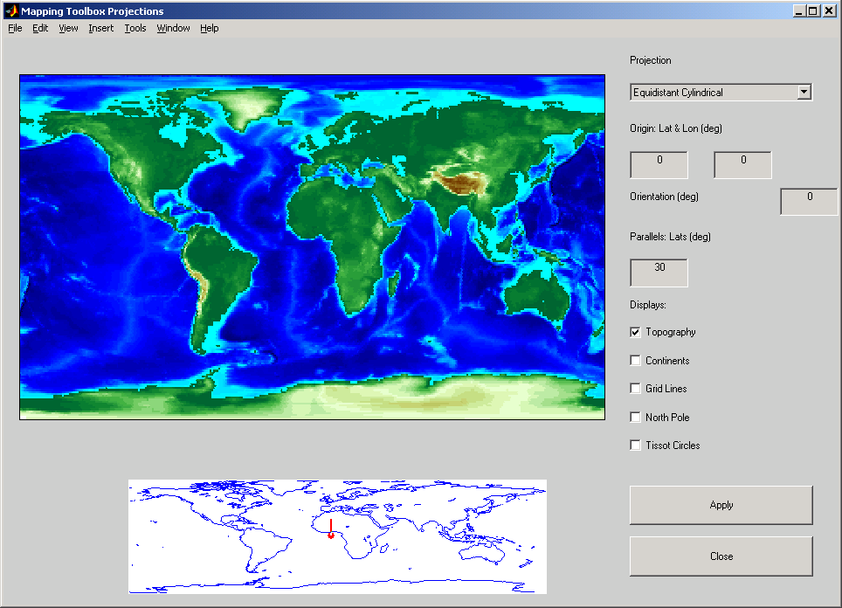
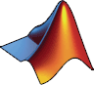

MathWorks at a Glance
Headquarters: Natick, Massachusetts US
Other U.S. Locations: California; Michigan; Texas; Washington, DC
Europe: France, Germany, Italy, Spain, the Netherlands, Sweden, Switzerland, U.K.
Asia-Pacific: Australia, China, India, Japan, Korea
Worldwide training and consulting
Distributors in 25 countries
Earth’s topography on an equidistant cylindrical projection, created with MATLAB and Mapping Toolbox.

Slide 8
MathWorks Today
Revenues ~$600M in 2010
Privately held
More than 2000 employees worldwide
Worldwide revenue balance: 45% North America, 55% international
More than 1 million users in 175+ countries

Slide 9
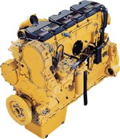
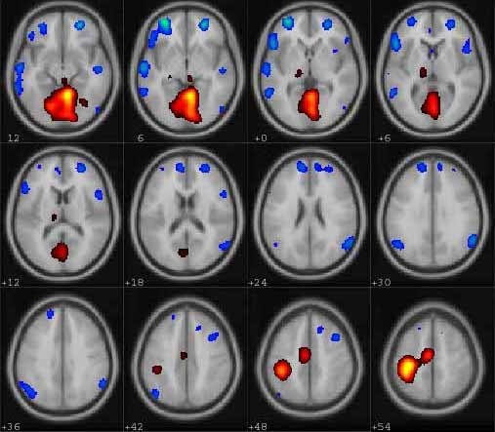

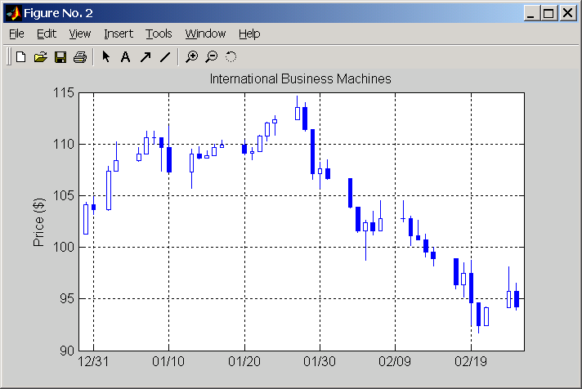
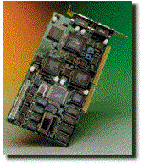

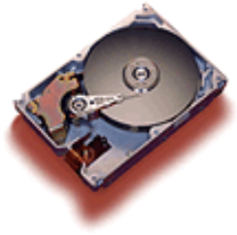
Key Industries
Aerospace and defense
Automotive
Biotech and pharmaceutical
Communications
Education
Electronics and semiconductors
Energy production
Financial services
Industrial automation and machinery

Slide 10
Agenda
Introduction
Battery testing
Analog, digital, and CAN data acquisition
Test setup
Battery data analysis techniques
Organize and document acquired data
Align, filter, and repair data
Modeling Li-Ion batteries with thermo properties
A
B
C
Notes:
Introduction
Battery testing & data acquisition (value proposition: one environment from data acquisition to analysis, online analysis and alarms, and etc.)
Demo of DAT and VNT (also shows xPC Target as part of the setup)
Data analysis (organizing data into datasets, time-aligning traces, repairing datasets, identifying outliers, and etc.)
Demo of ML + Stat + Curve Fitting Toolboxes
Battery modeling (using the lithium battery model under development by Javier)
Demo of Simscape and Simulink Design Optimization (also shows PCT)
Acquiring battery discharge data and CAN messages from ECUs using data acquisition hardware directly into MATLAB for analysis
Analyzing acquired data by aligning traces with different timestamps, repairing datasets with missing data, and rejecting noisy data

Slide 11
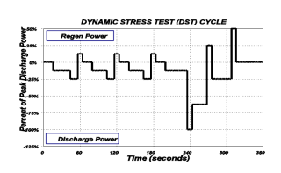
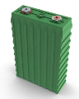
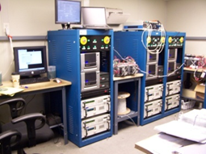
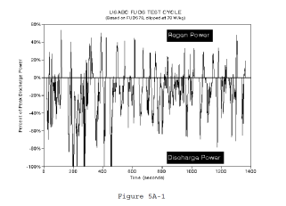
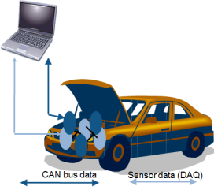
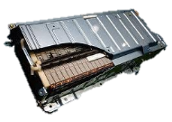
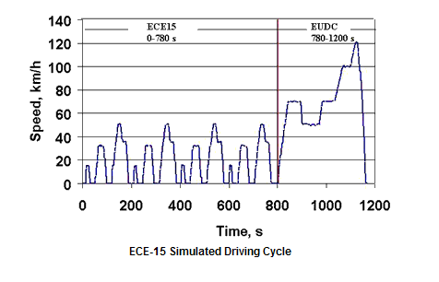
Battery Testing Scenarios
Test procedures
Lab-based testing
Cell
Testing
Pack
Testing
Vehicle-based testing
Notes:
Intro to battery testing technologies, standard seminar boiler plate, challenge slide (15 min)
John’s part (1 hr), 15 minute product wrap up, battery modeling segment (40 minutes), 5 minutes boiler plate
The purpose of this slide are
Establish some basic common vocabulary
Establish that we have an understanding of battery testing

Slide 12
Battery Testing Scenarios
Test procedures
Battery characterization
Battery modeling
Stress test
Battery diagnostics
SOC estimation
Battery management system calibration
Vehicle performance validation
Durability and aging study
…
Lab-based testing
Cell
Testing
Pack
Testing
Vehicle-based testing

Slide 13
A Few Common Challenges with Battery Test and Data Analysis
Data integrity
Detect intermittent connections
Handle missing data
Data analysis
Consolidate datasets with different time scales
Isolate data from noise
Identify outliers
Time consuming
Impact Data quality

Slide 14

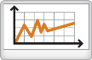







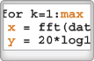


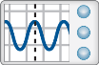
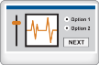

A Technical Computing Workflow for Battery Test and Data Analysis
Access
Explore & Discover
Share
Files
Reporting and Documentation
Data Analysis & Modeling
Software
Algorithm Development
Outputs for Design
Code & Applications
Application Development
Hardware
Deployment
Automate
Notes:
Aerospace and Defense Industry Session
2007 Worldwide Kickoff
14
NOTE – this assumes that you’ve positioned MATLAB already, to some extent, as the center of your workflow
(CLICK)
The first step in this workflow is to get your data – we’ll call this our Access step.
MATLAB provides many ways to do this…
Through files on disk. It might be an Excel file, or a plain text file.
Through other S/W applications… perhaps a data acquisition system, or another programming language
Or it could be through H/W, such as T&M equipment, or a set of sensors…
(CLICK)
Once inside MATLAB, we have the Explore & Discover step.
This is really why you’re using MATLAB – to find something out about your problem - you might say you’re here to decide something - to make a decision.
Some of the specific tasks you might do in MATLAB include:
Data Analysis
Algorithm Development
Creating and developing applications
These are the things that MATLAB is well known for.
Now what’s your next step?
(CLICK)
Well, in most cases, you have to do something actionable with your results. This is what we call our Share step.
It might be creating a report to share with your colleagues.
Or perhaps your work may be directly involved in a particular aspect of the design process – so your results might feed your downstream design tools.
Or if you’ve created an application, you may want to deploy it to another environment – perhaps by creating a stand-alone application for someone else, or even integrating it into another environment, such as Excel.
We’ll use this workflow throughout the day to help us in our discussions.
Hopefully you’ll see that MATLAB’s integration allows all of these steps to be managed from a single environment.
One other important factor to consider as we look at this workflow is that engineering and science often requires us to repeat our steps – perhaps because we have new design constraints, or someone’s asked us to refine our analysis approach – or we just have additional data that needs to be analyzed.
(CLICK)
MATLAB provides a convenient way to automate the work that you’ve done, so that you can easily reuse it moving forward. This will be an important part of today’s discussion.

Slide 15
Battery Testing, Data Analysis, and Modeling Using MATLAB and Simulink

Slide 16
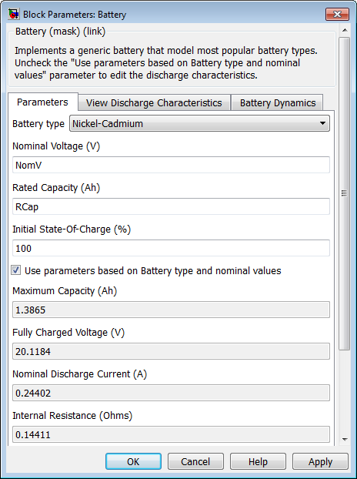
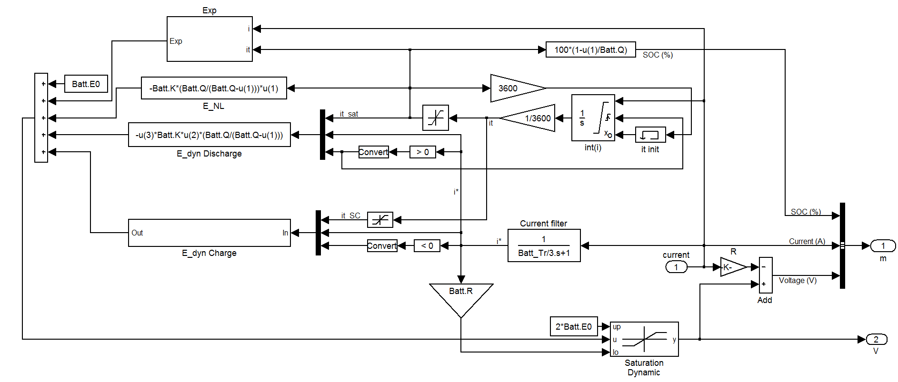
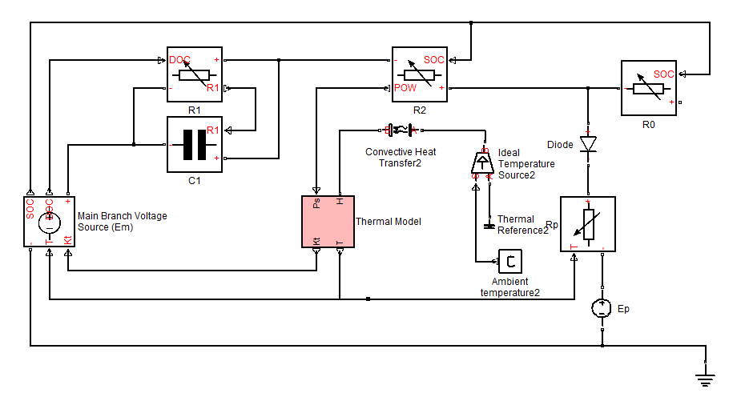
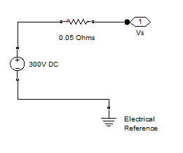
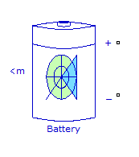
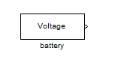
Introduction
The scope of battery testing and data analysis in this seminar is battery modeling and model validation
How to create a Battery model (Use Case)
Important aspects of creating a Battery model
What does a Battery model look like?

Slide 17
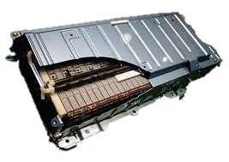
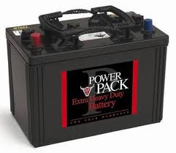
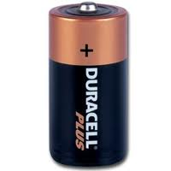




What Did I Model?

Slide 18
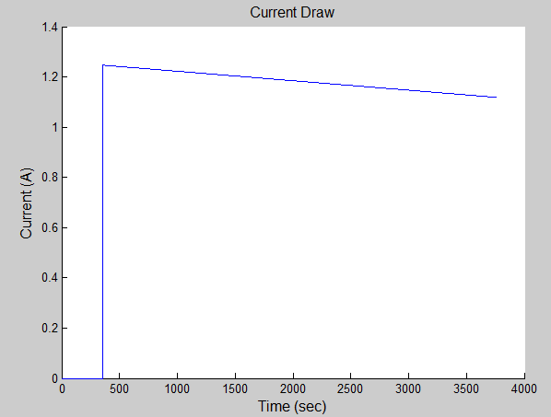
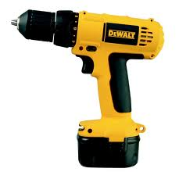
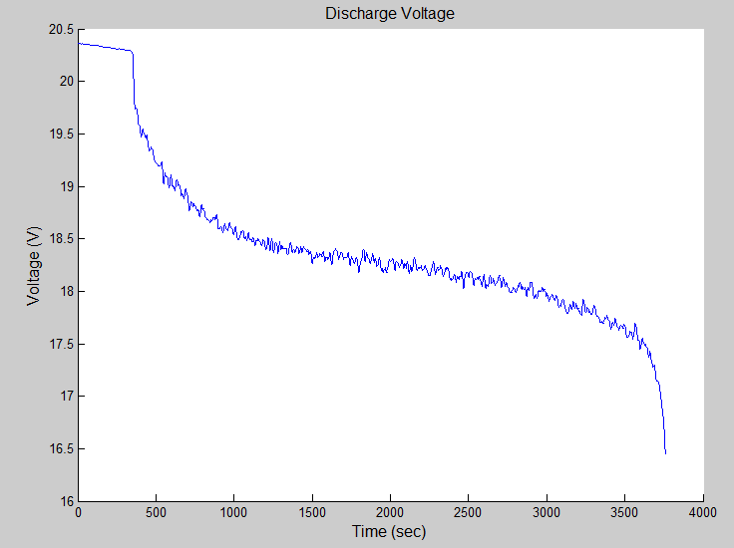
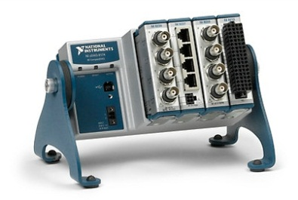
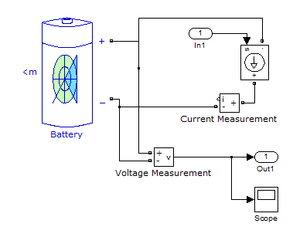
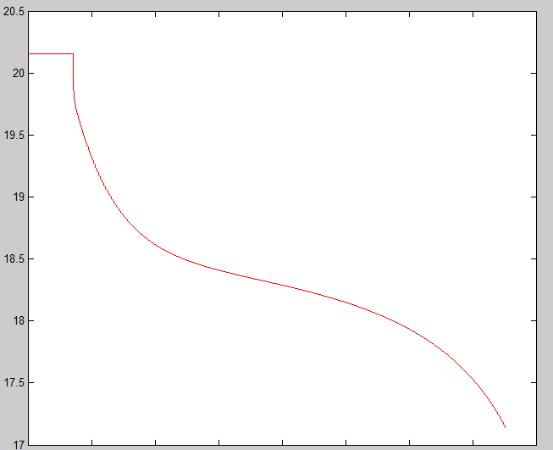
Model Correlation
Physical Hardware
Simulation

Slide 19
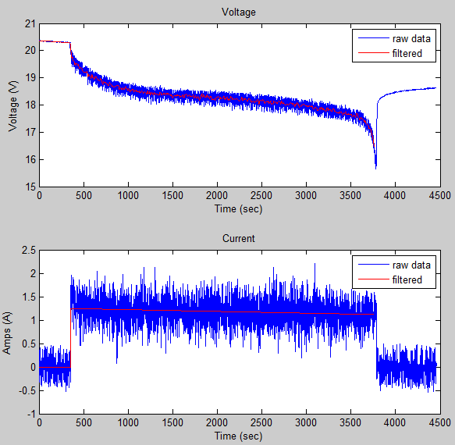
Before We Can Apply the Data…

Slide 20
Before We Can Apply the Data…
Data collection
Types of data
Analog/PWM/Digital
CAN
Data integrity
Detect intermittent connections
Signal threshold limits
Data analysis
Data filtering
Curve fitting
Smoothing
Data synchronization
Consolidate datasets with different time scales
Handle Missing Data
Drop outs

Slide 21
A Technical Computing Workflow for Battery Test and Data Analysis
Access
Explore & Discover
Share
Files
Reporting and Documentation
Data Analysis & Modeling
Software
Algorithm Development
Outputs for Design
Code & Applications
Application Development
Hardware
Deployment
Automate
Notes:
Aerospace and Defense Industry Session
2007 Worldwide Kickoff
21

Slide 22
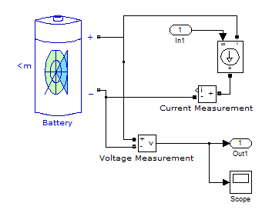
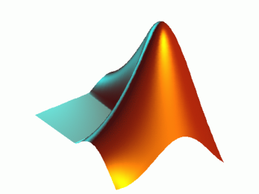
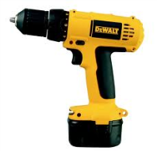

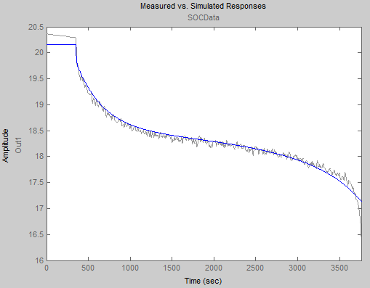
A Technical Computing Workflow for Battery Test and Data Analysis
Access
Explore & Discover
Share
Files
Data Analysis & Modeling
Reporting and Documentation
Software
Algorithm Development
Outputs for Design
Code & Applications
Application Development
Hardware
Deployment
Notes:
Aerospace and Defense Industry Session
2007 Worldwide Kickoff
22

Slide 23
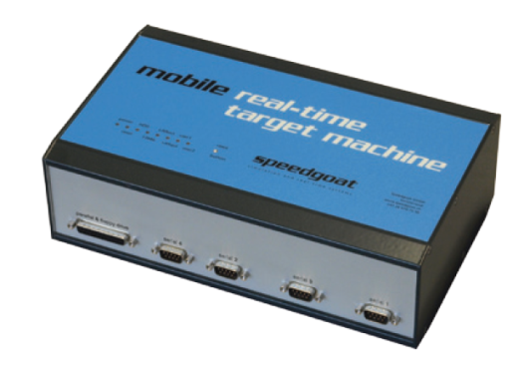
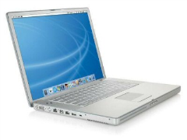
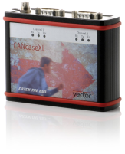


Data Collection
Analog (V,I)
CAN
Data collection
Types of data
Analog/PWM/Digital
CAN
Data integrity
Detect intermittent connections
Signal threshold limits
Notes:
Add drive pattern

Slide 24
Demo
Run the main model
Make some plots
Showing bring data directly in
Show VNT / Can Tool
Show the data integrity stuff demo

Slide 25

A Technical Computing Workflow for Battery Test and Data Analysis
Access
Explore & Discover
Share
Files
Data Analysis & Modeling
Reporting and Documentation
Software
Algorithm Development
Outputs for Design
Code & Applications
Application Development
Hardware
Deployment
Notes:
Aerospace and Defense Industry Session
2007 Worldwide Kickoff
25

Slide 26









MATLAB Connects to Your Hardware Devices
Data Acquisition Toolbox
Plug-in data acquisition devices
and sound cards
Vehicle Network Toolbox
CAN bus interface devices
Instrument Control Toolbox
Instruments and RS-232 serial devices
Image Acquisition Toolbox
Image capture devices
MATLAB
Interfaces for communicating with everything
Notes:
<Transition>
Now I’d like to drill down deeper into MATLAB’s capabilities for connecting to test equipment. …
NOTE: Intro Toolboxes here.
One of the key takeaways from this seminar is that there are ways to connect MATLAB to your hardware, with most of the common ones being supported directly by one of our three Test and Measurement Toolboxes. For those who may not be familiar with the concept of toolboxes, let me briefly describe their purpose. MATLAB is well known for it capabilities in numerics, analysis, visualization, and algorithm development. However, additional tools and functions that extend these core capabilities can be provided through packages called toolboxes. MATLAB’s open architecture gives it the natural ability to connect to hardware through means that I will soon describe. However, the Test and Measurement Toolboxes extends this ability to make access easier to common hardware devices in three major categories: plug-in data acquisition boards, image capture devices, and electronic and scientific instrumentation.
Plug-in data acquisition boards
With Data Acquisition Toolbox, we provide connectivity with general-purpose boards which perform analog to digital and digital to analog conversions, along with direct digital input/output communication.
Image capture devices
The Image Acquisition Toolbox is how MATLAB sees the world. It provides connectivity for a wide range of consumer and scientific-quality devices used to capture video to a computer. Examples include Web cameras and scientific cameras, as shown here.
Electronic and scientific instrumentation
The Instrument Control Toolbox is the toolbox responsible for providing communication with stand-alone instruments such as digital oscilloscopes, function generators, power supplies, and network analyzers. Since the communication is through a standard interface, like GPIB, serial, or Ethernet, this solution enables you to connect to any device which uses a supported interface.
Everything else that doesn’t fit neatly into these categories
And what about the devices that aren’t supported by these three toolboxes? As I said at the beginning of this slide, MATLAB’s open architecture gives it the innate ability to connect to hardware. Let’s say that you might need to communicate with things like a proprietary data acquisition system, or maybe an airplane’s 1553 network, or maybe a boutique plug-in card. The many external hooks found in MATLAB can be used to access devices like these. Examples of these hooks are ActiveX, COM, and Windows drivers. Not to mention popular programming languages such as C, FORTRAN, and Java.

Slide 27

Data Acquisition Toolbox Acquire and output data from data acquisition boards
Immediately analyze live or acquired data in MATLAB and Simulink
Configure hardware without leaving MATLAB
Incorporate custom analysis into PC-based digital oscilloscope
Ability to do “one-shot” or continuous acquisition
Support multiple data acquisition devices and vendors
Notes:
Now that I have shared some of the key features of the three toolboxes, let’s take a more detailed look at them.
The Data Acquisition Toolbox provides a complete set of tools for handling analog input and output, and also digital I/O data for a variety of PC-compatible data acquisition hardware. The toolbox enables you to easily configure your hardware devices, read in single-shot or continuous streams of data for analysis, and send out data all from the MATLAB environment. There is also the ability to easily customize your acquisitions, access the built-in features of your hardware devices, and incorporate the analysis and visualization features of MATLAB and other related toolboxes.
In addition there is a built-in oscilloscope in which you can incorporate custom MATLAB algorithms.
Now let’s look at the hardware supported by this toolbox…
Key Features
Interfaces for industry-standard data acquisition devices
Access to live, measured data directly from MATLAB
Single integrated environment for data acquisition, analysis, and visualization
Analog input, analog output, and digital I/O
SoftScope software oscilloscope for streaming data into a graphical display
Direct interface to supported board features, such as single-channel and multichannel acquisitions and single-point and buffered analog I/O
Hardware and software triggers
Adaptor kit for creating custom interfaces to unsupported hardware

Slide 28


Data Acquisition Toolbox
What kind of hardware can I use?
Supports for a variety of data acquisition boards and USB modules
Key Features
Support for analog input, analog output, counters, timers, and digital I/O
Direct access to voltage, current, IEPE accelerometer, and thermocouple measurements
Live acquisition of measured data directly into MATLAB or Simulink
Hardware and software triggers for control of data acquisition
Device-independent software interface
Notes:
Why is it useful?
To enable researchers, scientists and test engineers to control and acquire data from data acquisition devices
To enable live analysis of measured data and automation of repetitive testing tasks
Who can use it?
MATLAB and Simulink users in all industries

Slide 29
Data Acquisition Toolbox: Supported Hardware
Agilent*
ADLINK*
Advantech
CONTEC*
Data Translation*
g.tec*
IOTech*
Keithley
Measurement Computing (MCC)
National Instruments
Ono Sokki*
United Electronic Industries*
VXI Technology
Any PC compatible sound card (AI, AO)
Parallel Port (DIO)
* Denotes that the hardware manufacturer made the investment to provide this support
For a full support listing, visit: www.mathworks.com/products/daq
Notes:
(Not much to say here. I emphasize that the interface to all of this hardware is the same. I like to mention the sound card and parallel port– you can prototype in your office with your sound card, take the same code to your lab to run on your real hardware. Or, with these two, you have the world’s cheapest T&M hardware setup! Make sure you mention that a full list of support cards for each vender is available on the Data Acquistion Toolboxes product page.)
F

Slide 30


Vehicle Network Toolbox Communicate with in-vehicle networks using CAN protocol
MATLAB functions for transmitting and receiving CAN packets
CAN communication blocks for connecting a CAN bus to a Simulink model
Bit packing and unpacking functions and blocks for simplified encoding and decoding of CAN messages.
Message traffic GUI for visualizing live CAN network traffic
Ability to filter and log CAN messages
Support for Vector and Kvaser interface hardware and Vector CAN database (.dbc) files
Notes:
Now that I have shared some of the key features of the three toolboxes, let’s take a more detailed look at them.
The Data Acquisition Toolbox provides a complete set of tools for handling analog input and output, and also digital I/O data for a variety of PC-compatible data acquisition hardware. The toolbox enables you to easily configure your hardware devices, read in single-shot or continuous streams of data for analysis, and send out data all from the MATLAB environment. There is also the ability to easily customize your acquisitions, access the built-in features of your hardware devices, and incorporate the analysis and visualization features of MATLAB and other related toolboxes.
In addition there is a built-in oscilloscope in which you can incorporate custom MATLAB algorithms.
Now let’s look at the hardware supported by this toolbox…
Key Features
Interfaces for industry-standard data acquisition devices
Access to live, measured data directly from MATLAB
Single integrated environment for data acquisition, analysis, and visualization
Analog input, analog output, and digital I/O
SoftScope software oscilloscope for streaming data into a graphical display
Direct interface to supported board features, such as single-channel and multichannel acquisitions and single-point and buffered analog I/O
Hardware and software triggers
Adaptor kit for creating custom interfaces to unsupported hardware

Slide 31

CAN Message Traffic GUI
Typical Workflow
Use canTool to view data that is currently on the CAN bus
View Timestamp, ID, and Data
Export messages for offline analysis
Shows signal names and physical values for messages associated with .dbc files
Benefits
This GUI can be run in conjunction with other MATLAB and Simulink toolbox operations, providing a window on the current communication history of the network.
Notes:
Motivation
A basic traffic visualization tool is a standard feature of CAN network analysis tools. In conjunction with any detailed network testing, analysis, or simulation the user may be doing, the ability to simultaneously see what is happening directly on the live network is an invaluable debugging and troubleshooting capability.
Solution (Added Details)
VNT provides a simple network visualization utility capable of connecting to a single live network. Basic controls are provides to choose the desired interface channel and manipulate it via start, stop, and pause operations. Furthermore, a user may choose to export the shown message log to a MAT file any time the GUI is paused or stopped. Also, a user may choose to view the network traffic as either a scrolling history of all messages or in a reduced view that will show only the most recent occurrence of each unique message on the network. In R2011a, the GUI can decode messages that are associated with a CANdb file.
Doc Reference
TBD
Demo
While connected to CAN network, type canTool to bring up the GUI and inspect the traffic on it. This can also be used in combination with the demo entitled “Basic CAN communication” to illustrate the visualization of data created and sent using that demo.
Limitations, Known Problems, and Workarounds
The VNT GUI is a single window that can visualize only one network at a time.
Display of signal names and values (for channels associated with .dbc file) is only available when the GUI is stopped.
The VNT GUI only exports message data to MAT files in a limited manner. It will export to the current working directory to files using toolbox defined names. If a user wants to take a message log from the GUI into MATLAB, they must export and then import as a two-step operation.
On very fast networks with a large quantity of traffic, performance of the GUI and other running applications within MATLAB or Simulink related to CAN communication could be a concern.
Questions and Debugging Tips (for MathWorks Support team)
None.
Release Number – v1.4(R2011a)

Slide 32

CAN Message Logging and Replay
Typical Workflow
Log a set of CAN messages by using the receive command for a set period of time
Save the messages to a MAT-file by using the save command or by exporting from canTool
At a later time, reload the MAT-file containing the CAN messages and use the replay command to send out the same messages while preserving the original timestamp differentials
Benefits
Log large message sets in-vehicle, bring the log back to the desk or bench, and replay it in an in-the-loop or simulated test system
Notes:
Motivation
Developing distributed control systems and validating network operation often involves obtaining, analyzing, and replaying message logs of varying size.
Solution (Added Details)
Logging messages in VNT is a simple matter of creating a channel and receiving messages over time. Messages can be saved to MAT files for portability and storage. The VNT GUI also provides a means to export messages to MAT files for later use. VNT also provides a replay function in MATLAB that goes beyond the normal transmit capability. Replay will take a log of CAN messages and resend them while keeping the time differentials of the original reception timestamps.
Doc Reference
TBD
Demo
This can be shown interactively. There is no special demo included with the product to illustrate this feature.
Limitations, Known Problems, and Workarounds
None.
Questions and Debugging Tips (for MathWorks Support team)
None.
Release Number – v1.0 (R2009a)

Slide 33



CAN Message Filtering
Typical Workflow
Filter by message ID to limit data to what you need for a particular application
Select a message ID or set of message IDs to accept or block
Access from MATLAB command line or CAN Receive block mask settings
Notes
Filtering can eliminate the need to perform extra message parsing steps during analysis by capturing only the desired message traffic from the network.
This type of filtering is implemented in the Vector hardware, but programmed from MATLAB.
Notes:
Motivation
In most cases, there is more communication on a CAN network than any one specific user may care about. In this case, it is valuable to potentially remove any extraneous message by filtering out the unwanted messages.
Solution (Added Details)
In MATLAB, once a channel is created, several filter operations can be performed for the channel. This involves directly setting a bitwise filter by hand or more commonly using the add/block range functions. The add/block range are much easier to use as they do not involve any direct bit field calculating. In Simulink, receive blocks can configured with filtering options so that the block will only pass the specified messages.
Doc Reference
TBD
Demo
The product contain a demo called “Using Filters on a CAN channel” to illustrate these features. The demo does not require hardware as it uses Vector virtual channels. Installation of the Vector software drivers and libraries is required. You can execute the demo by typing demoVNT_FilteringCANMessages at the command line. However, since this demo is designed to be more of a tutorial, it is recommend that you access this demo by navigating to it from the MATLAB start menu or by opening the m-file in the editor. In this way, you can step through the demo and evaluate selections. Running the full demo will execute all steps and it will not be clear what happened.
Limitations, Known Problems, and Workarounds
When using the MATLAB add/block range functions, they only work for standard CAN identifiers. If a user wants to set filters for extended identifiers in MATLAB, they must use the manual bit field filter method.
Each channel created in MATLAB has only one filter; however, you can have multiple channels each configured to pass different messages. The flexibility of the channel model is very useful.
Resetting filters on a channel in MATLAB will reset for both standard and extended identifiers.
Note that even though we present filtering as employed via hardware, the extended identifier filter of the receive block is not a hardware filter. It is actually implemented as a software filter in the block code. The standard identifier filter on the receive block uses the device’s true hardware filter though. All filtering in MATLAB is done via hardware filters.
Questions and Debugging Tips (for MathWorks Support team)
Note that if a user is trying to put together MATLAB code or a Simulink model using VNT and encountering performance issues, employing filtering should be a first step to hopefully reduce overhead and improve performance in message handling throughput. The faster or large quantity of traffic there is on the network, the more valuable filtering becomes.
Release Number – v1.0 (R2009a)

Slide 34




Support for Vector CANdb Databases
Typical MATLAB Workflow
Open the Vector .dbc database file from MATLAB
Use the messageinfo command to find out the names and IDs of the defined messages and any defined Signals
Use signalinfo to find out the properties of the signals that make up the message
Construct or interpret messages using the database and real engineering units
Benefits
Users can easily import their database files into MATLAB or Simulink. Signal properties (datatypes, signal length, byte order, etc.) are predefined, simplifying interaction with the CAN bus.
Notes:
Motivation
The CANdb DBC file format from Vector is the de facto standard for defining CAN networks. These databases describe a network in terms of its node layout, message list, and signal definitions containing within the messages. Most users, especially those in automotive, will have database files for the network on which they are developing modules or control systems. Supporting these databases and being able to access the information contained within greatly simplifies the user interface and addresses many of the pain points associated with using CAN.
Solution (Added Details)
In MATLAB, functions are provide allowing the user to access a CAN database file. The information in this file can then be used to build CAN messages for transmit by simply using the message and signal names. A database can also be attached to a CAN channel through which a user is receiving messages. In this case, all messages incoming will be automatically translated into a physical, symbolic name format. Using this feature, a user need not care about the complex, fine details of the network.
In Simulink, the packing and unpacking blocks support CAN database files as well. To configure a block for a specific message, a user can load a database file and simply pick the message they want the block to represent by name from a list. All of the signal definition information is then automatically loaded. At that point, the user need only connect their upstream or downstream blocks and focus on their application. The complex details of the network implementation once again are managed completely by the toolbox.
Doc Reference
TBD
Demo
The product contain a demo called “Using CANdb database files” to illustrate these features. The demo does not require hardware as it uses Vector virtual channels. Installation of the Vector software drivers and libraries is required. You can execute the demo by typing demoVNT_CANdbFiles at the command line. However, since this demo is designed to be more of a tutorial, it is recommend that you access this demo by navigating to it from the MATLAB start menu or by opening the m-file in the editor. In this way, you can step through the demo and evaluate selections. Running the full demo will execute all steps and it will not be clear what happened.
Limitations, Known Problems, and Workarounds
None.
Questions and Debugging Tips (for MathWorks Support team)
None.
Release Number – v1.4 (R2011a)

Slide 35







Vehicle Network Toolbox: Supported CAN Interface Hardware
CANBoardXL(PCIe)
CANcaseXL (USB)
CANcardXL (PCMCIA)
Support for most Vector PCMCIA, PCI, USB, and PXI CAN devices
New in R2010a
LapCAN II (PCMCIA)
PCIcanx
USB CAN II
Leaf Light (USB)
Support for most Kvaser WLAN, PCMCIA, PCI, ISA and USB CAN devices
Support for National Instruments CAN devices (PXI, USB, PCI, PCMCIA)
New in R2011a
Supported Hardware Page:
http://www.mathworks.com/products/vehicle-network/supportedio.html

Slide 36



Instrument Control Toolbox Control and communicate with test and measurement instruments
Integrate instruments into MATLAB applications and Simulink models
Interactive tool for detecting and controlling instruments
Automatic code generation for faster and easier implementation
Support for IVI, VXIplug&play, and MATLAB instrument drivers
Support for common communication protocols
Notes:
The last of the Test & Measurement toolboxes to talk about is the Instrument Control Toolbox.
This toolbox lets you communicate with instruments, such as oscilloscopes, function generators, and analytical instruments, directly from MATLAB. It is made all the easier with a built-in tool called TMTool. This tool allows you to investigate your instruments from an interactive, graphical interface. It also makes use of standard instrument drivers , such as IVI and VXIplug&play, for more of a point and click type of environment. Actual MATLAB code can be generated from your work with in the tool, which can then be easy implemented into applications to automate your test setups.
Let’s take a look at the protocols the toolbox supports…
Key Features:
Instrument driver support for IVI, VXIplug&play, and MATLAB instrument drivers
Support for GPIB and VISA standard protocols (GPIB, GPIB-VXI, VXI, USB, TCP/IP, serial)
Support for networked instruments using the TCP/IP and UDP protocols
Simulink blocks for sending and receiving live data between instruments and Simulink models
Graphical user interface for identifying, configuring, and communicating with instruments
Hardware availability, management, and configuration tools
Instrument driver development and testing tools
Functions for reading and writing binary and text (ASCII) data
Synchronous and asynchronous (blocking and nonblocking) read-and-write operations
Event handling for time-out, bytes read, data written, and other events
Recording of data transferred to and from instruments

Slide 37

Instrument Control Toolbox: Supported Hardware
Instruments from Agilent, Anritsu, LeCroy, Rohde & Schwarz, Tabor, Tektronix, and others
Instruments and devices supporting common communication protocols (GPIB, VISA, TCP/IP, UDP, and serial)
Serial devices – Any device with a RS-232, RS-422, or RS-485 interface (EEGs, gas chronometers, mass spectrometers, etc.)
Instruments using industry-standard instrument drivers (IVI, VXIplug&play, LXI)
For a complete list, visit www.mathworks.com/products/instrument/supportedio.html
Notes:
Instrument Control Toolbox provides support for four different communication protocols.
First, the toolbox provides support for instruments that are GPIB capable. GPIB boards provided by Agilent Technologies, National Instruments, Measurement Computing and others are supported by the toolbox.
The toolbox also provides communication with serial port devices, GPIB capable instruments, VXI instruments and GPIB-VXI instruments through the VISA standard. The VISA standard was developed by Agilent Technologies and National Instruments and provides a common language for communicating with these types of instruments regardless of the communication interface used. In addition to GPIB, VISA allows communication to compatible devices over TCP/IP and USB.
Why use Visa? Primarily for hardware that requires it, such as the VXI hardware and some Tek hardware. VISA is also required for high level instrument communication using Industry Standard IVI drivers.
Finally, the toolbox extends the serial port functionality provided in core MATLAB. Specifically, the toolbox provides methods for determining what ports are available on your machine, property information and help and tools (GUIs) for creating and communicating with a serial port device.

Slide 38
Summary of Data Access Solutions
Collect data directly from MATLAB or Simulink
Collect and Analyze the data in the same environment
Use this data to verify designs or as input to models
Make additional use of collected data

Slide 39



Products for Battery Parameterization
Simscape
Model and Simulate multi-domain physical systems
SimPowerSystems
Model and simulate electrical power systems
Simulink Design Optimization
Estimate and optimize Simulink model parameters
Notes:
Briefly describe what each product does and how it was used in the demo. Talk more about in second half of seminar??? Move to part 2

Slide 40










Book Program
More than 1200 books for educational and professional use, in 26 languages
Controls
Signal processing
Image processing
Biosciences
Communications
Mechanical engineering
Mathematics
Aerospace engineering
Environmental sciences
Chemistry
Finance
Electronics
Notes:
For more information, refer to mathworks.com/books.

Slide 41

Technical Support
Resources
Over 100 support engineers
All with MS degrees (EE, ME, CS)
Local support in North America, Europe, and Asia
Comprehensive, product-specific Web support resources
High customer satisfaction
95% of calls answered within three minutes
70% of issues resolved within 24 hours
80% of customers surveyed rate satisfaction at 80–100%
✓
✓
✓
✓
✓
Notes:
MathWorks Technical Support is a service provided to our existing customers that are under maintenance. The types of questions that our technical support staff can field are things like:
How do I…?
Can you explain this behavior?
This is a bug.
Can MathWorks products do this?
Here is a suggestion for the next version…
Technical support is one of MathWorks strengths: 90% of customers surveyed also indicate high satisfaction with our technical support services. [We do a daily transactional survey with a 48% response rate. 90% choose a rating of 8-10 with very positive remarks about our services.]
MathWorks is strongly dedicated to providing high-quality and timely technical support with a support staff of just under 10% of its total employee base.
All of MathWorks support engineers have MS degrees in engineering fields (electrical, mechanical, aerospace, chemical, etc.) or computer science. By design, their knowledge includes both MathWorks software and its applications. This is fundamental to our ability to provide strong support. The support organization is internally tiered with escalation procedures that can include direct collaboration with development staff.
In addition to the convenience of being able to quickly reach a knowledgeable human being, users can access MathWorks online support, which offers a growing supply of documents on a range of topics. Accessed by thousands daily, this site is a 24/7 resource for users.
For more information, refer to mathworks.com/support.

Slide 42

Next Steps
Lisa King??
Ph: 508-647-7658 lking@mathworks.com
Contact your account manager
Product trials
Site visits
Demos you saw today
Schedule training
Find online resources
MATLAB Central
Presentation slides
http://www.mathworks.com/matlabcentral/

